Slide 1
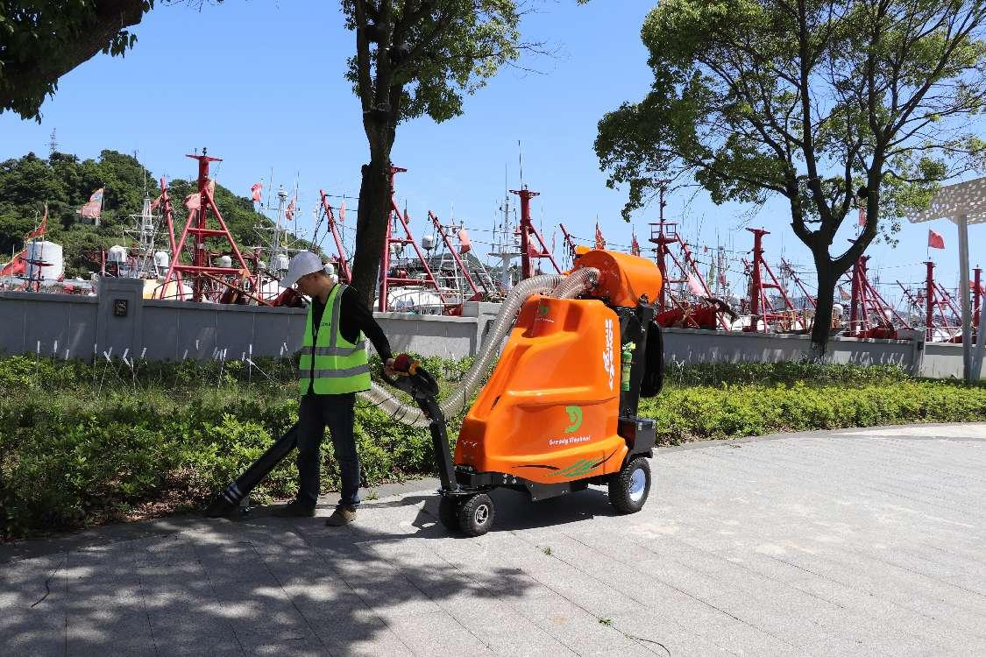
Elephant Trunk Garbage Collection Vehicle Profile
GE240
GE240
2024 Edition

Slide 2
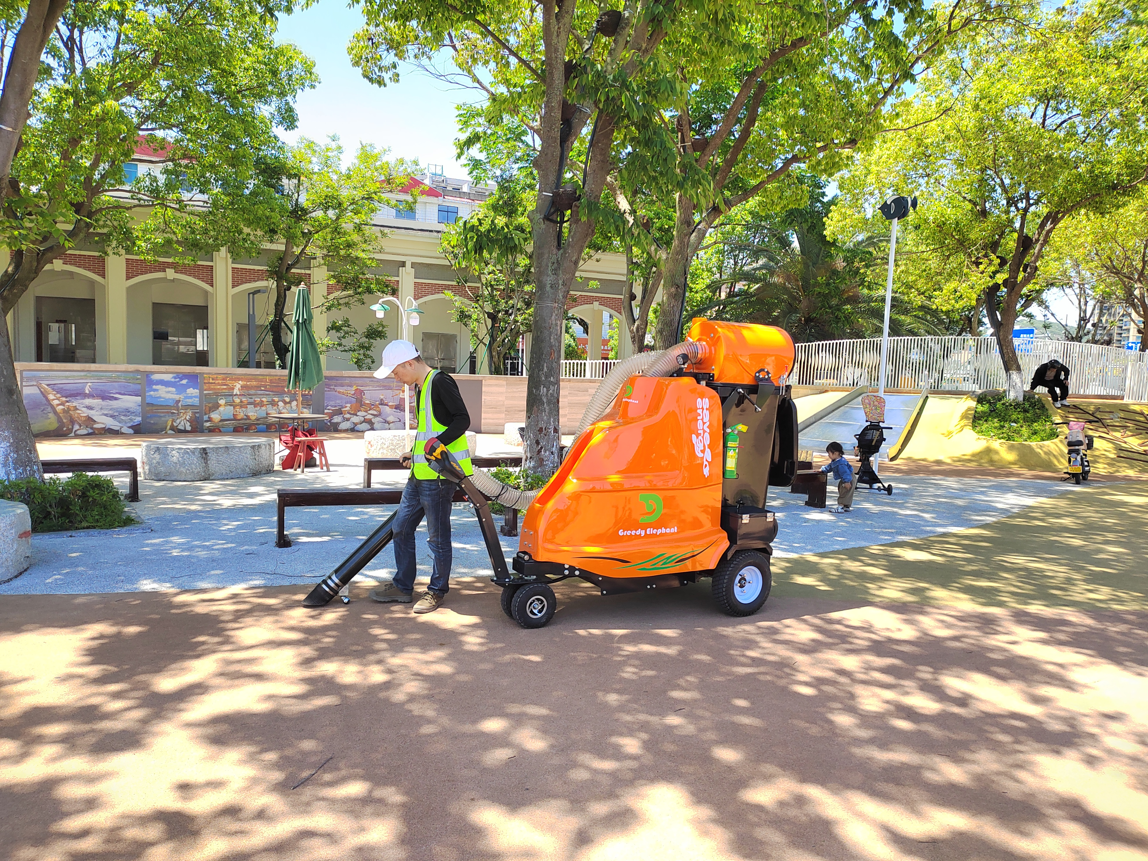
Catalog
1. Shape and size --------------------1-3
2. Principle of operation ---------------------4-5
3. Dust reduction methods ----------------------6
4、Driven type type ----------------------7
5. Steering mode ----------------------8
6. Description of operation and keys -----------------9-10
7. Battery-related instructions ------------------11-12
8. Description of high-pressure water guns ------------------13-14

Slide 3
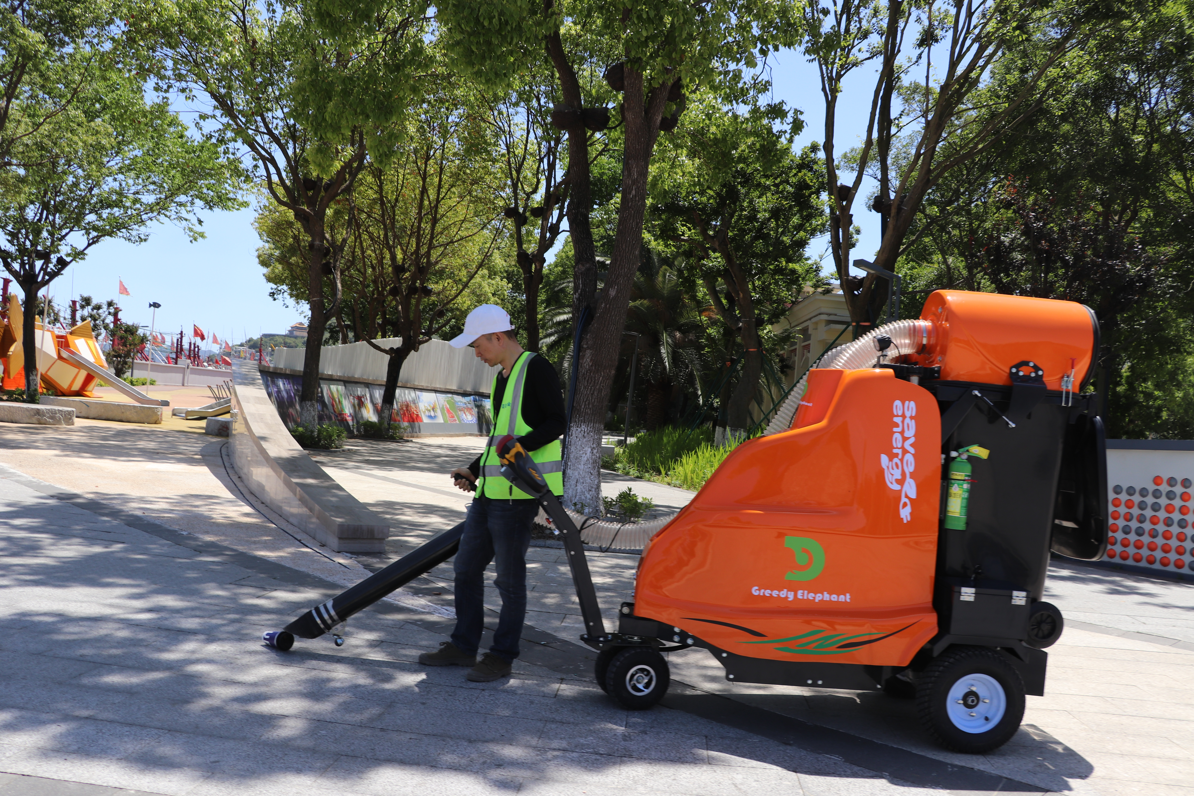
1. Shape and size
E
D
B
C
A
A:Wheelbase 1300mm
B:Height 1800mm
C:Width 910mm (outside tire width)
D: Handheld straw length 1000mm, diameter 110mm.
E: Vacuum hose diameter 110mm
1

Slide 4
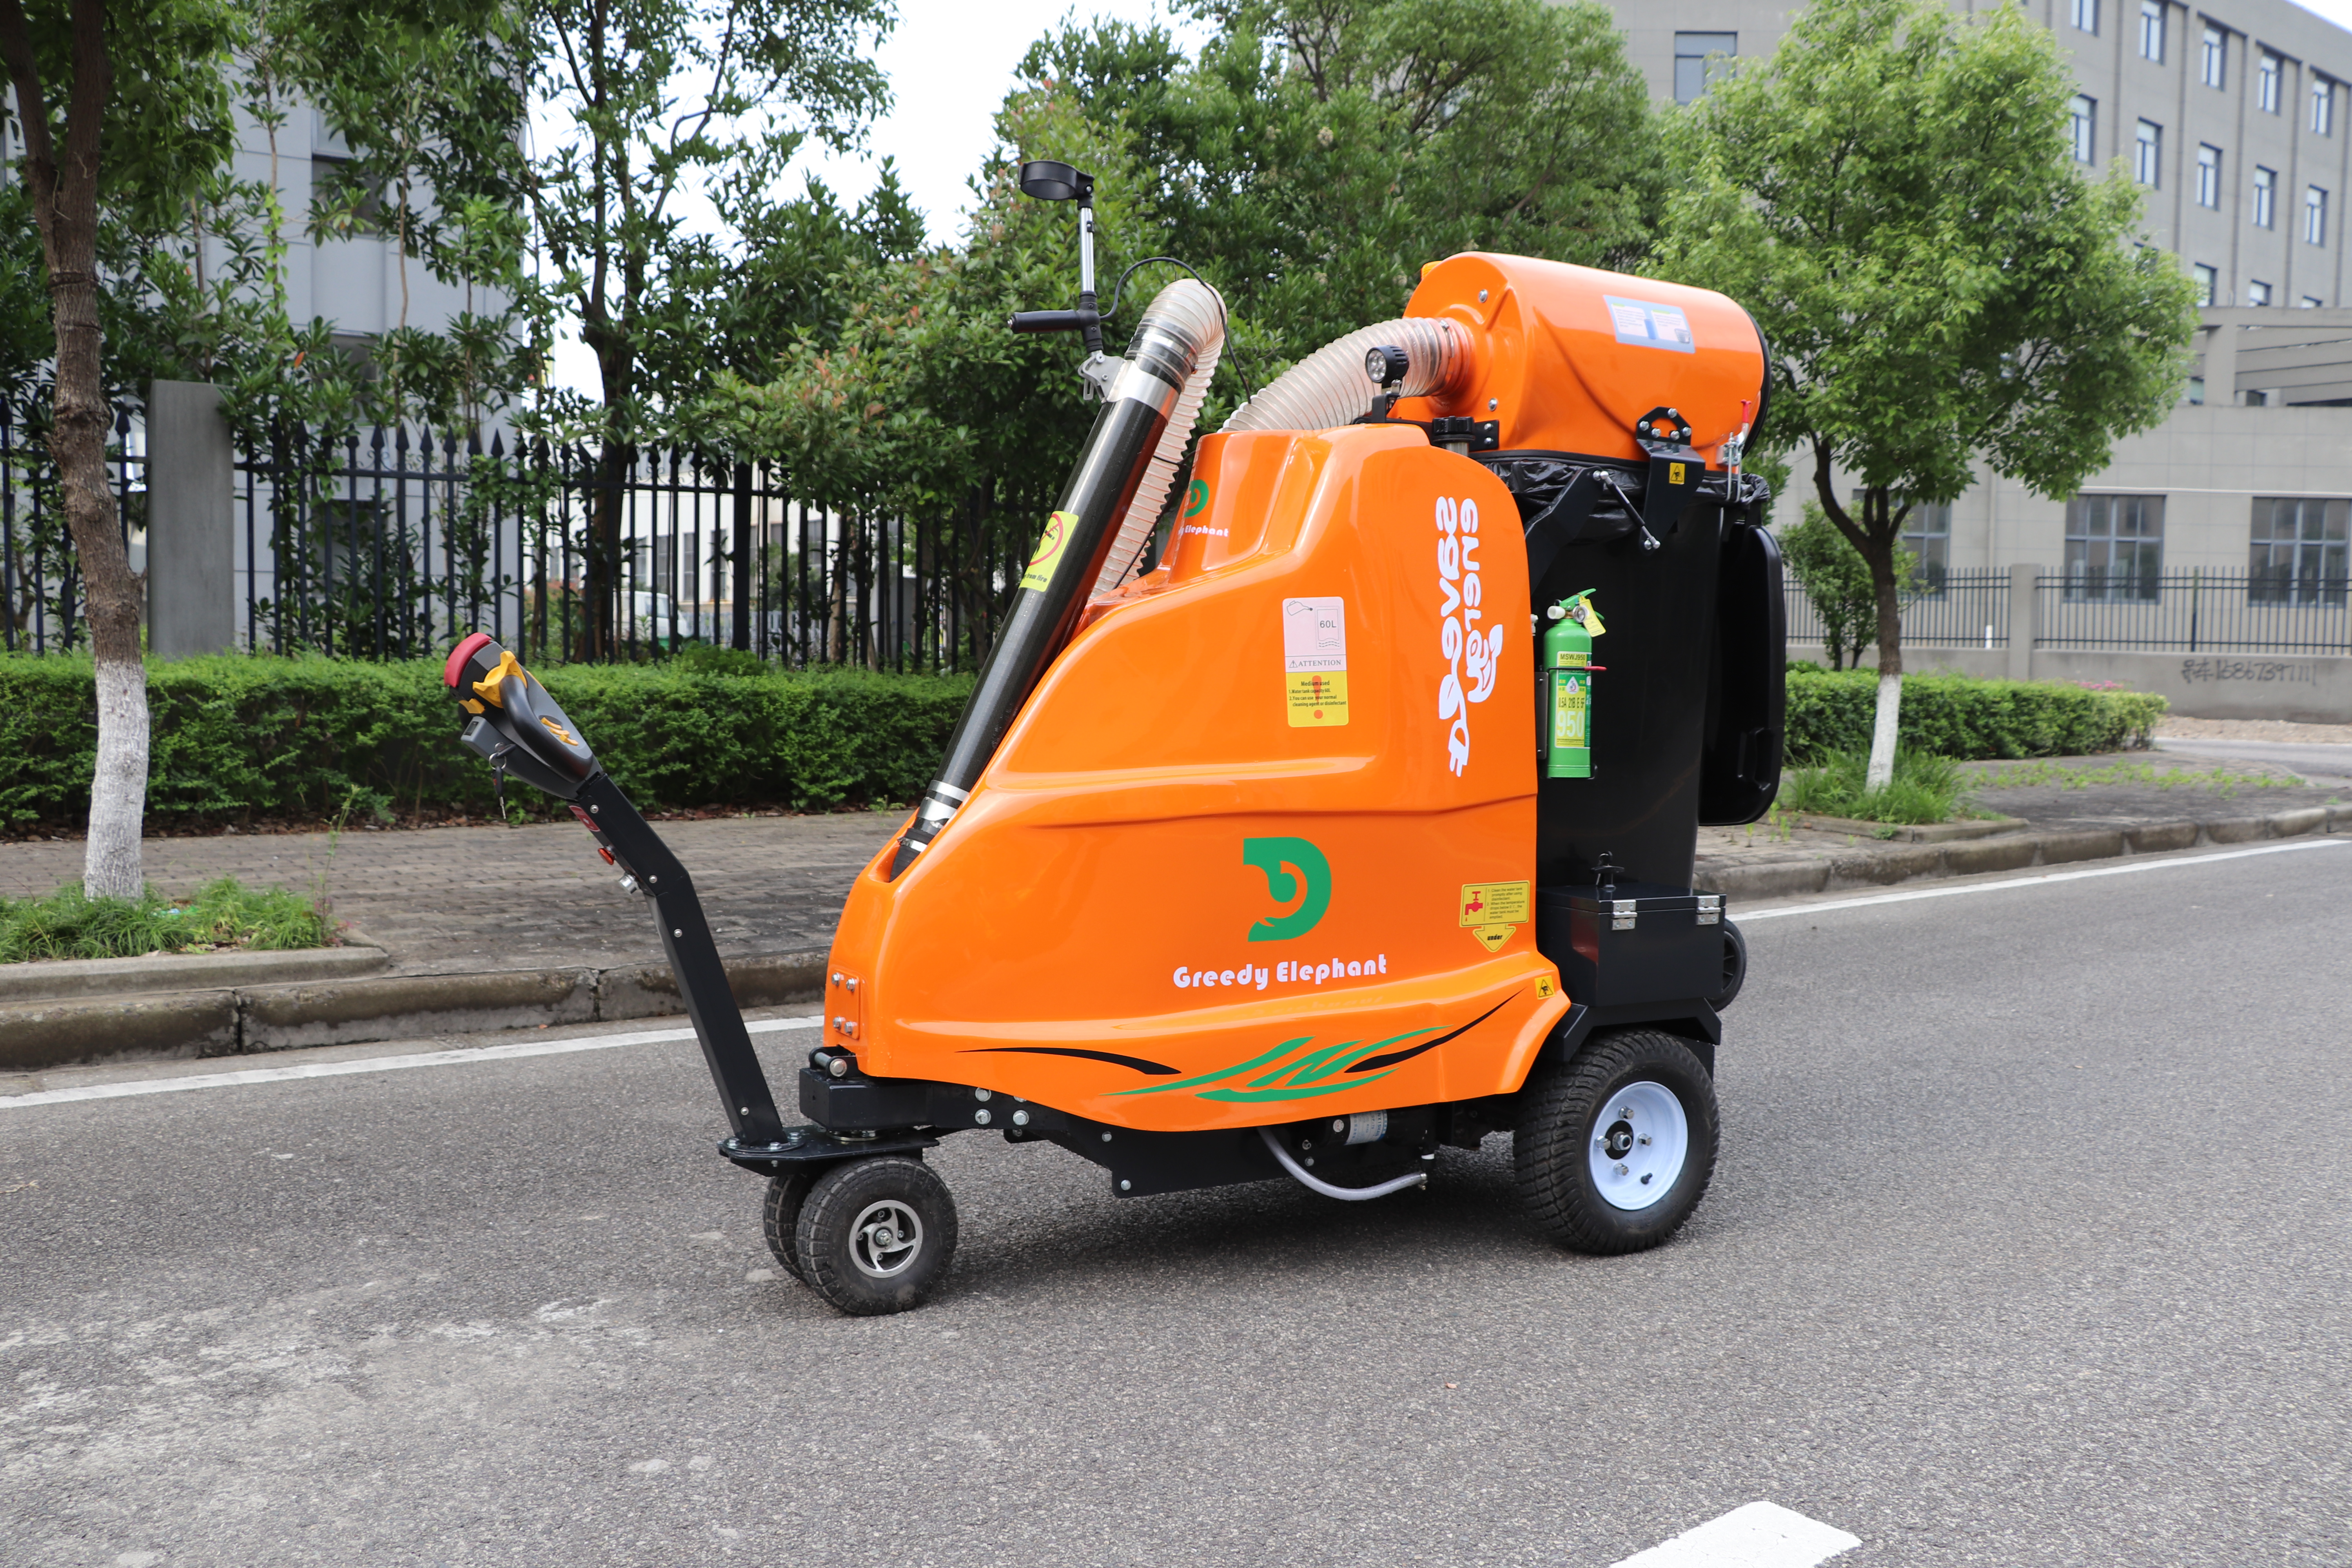
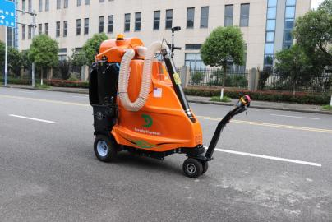
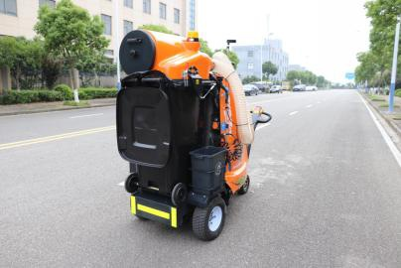
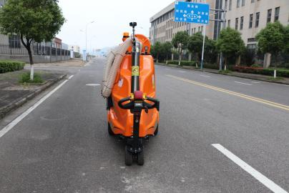
8
9
10
7
6
5
4
1
3
2
16
11
17
18
19
14
12
20
13
21
15
2

Slide 5
1. Steering wheels
2. Cleaning the pump
3. Driving wheels, electric rear axle drive.
4. Toolbox with key and lock.
5. Water-based fire extinguishers
6, garbage collection bin, 240L standard garbage can, standard with garbage can inner bracket.
7, Dust reduction filter, round fiberglass filter.
8. Vacuum hose A, this is the exhaust hose.
9、Control handle, control the vacuum fan on and off.
10, vacuum hard tube, carbon fiber manufacturing, lightweight and sturdy.
11, Vacuum hose B, this is the trash pickup hose
12. Controllers, including fan controllers, drive controllers, DCDC, etc.
13, battery, lead-acid maintenance-free battery, 12V84Ah battery 4.
14, Water tank, 60L stainless steel water tank.
15、Multi-functional steering control handle, can control the fan switch other than so control.
16. 12V LED warning light
17. garbage tongs
18, charging port, input 220V
19. High-pressure water gun
20. Dumpster 30L
21. 12V LED work light
3

Slide 6
2. Principle of operation
This is a pure suction type trash pickup cart. It utilizes vacuum negative pressure to suck the garbage to be picked up into the dumpster.
The red arrow indicates the suction air: the garbage passes through the hand-held suction hose and the vacuum hose and then enters the garbage bin.
The blue arrow indicates the exhaust air:The air inside the garbage can is discharged to the outside of the machine through the filter, the exhaust hose, the dust-absorbing fan (the curved thick arrow indicates the fan), and the deceleration and sound-reducing device.
4

Slide 7
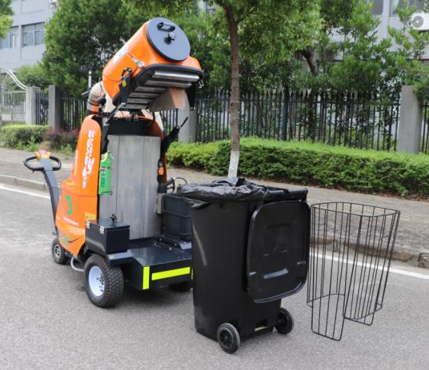
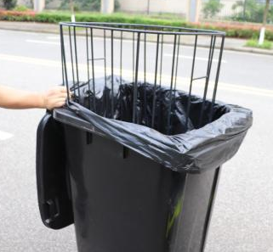
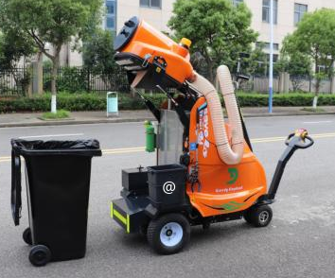
1
2
3
4
5
1、Exhaust filter, round fiberglass filter.
2, stainless steel filter mesh, mainly used to block the larger floating garbage.
3, stainless steel tank, used for dust and high-pressure cleaning, but also can be put disinfectant, after the use of disinfectant need to clean the tank, water pipes, water guns and so on.
4. 240L standard garbage bin for garbage collection.
5、Rubbish bag fixing frame, carbon steel spraying plastic.
5

Slide 8
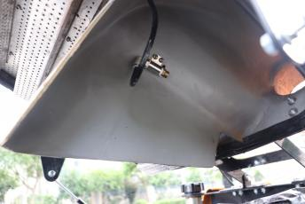
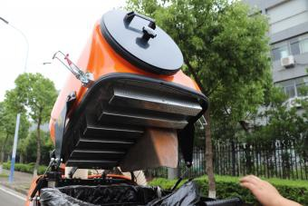
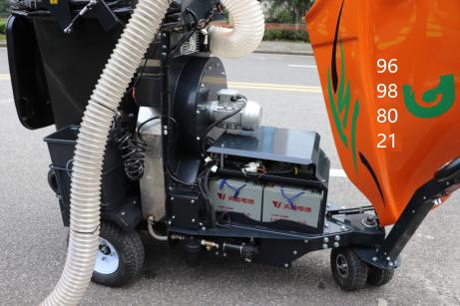
3. Dust reduction methods
Dust fall is divided into two parts.
1, vacuum hose mouth spray fine water mist dust, can be in the control handle at the cock switch control, by an independent small-displacement diaphragm pump to provide dust reduction water.
Diaphragm pump: pressure 3bar; flow rate 3L/min; voltage 12V
2, exhaust filter dust reduction, composed of a round fiberglass filter and related institutions, the filter can be manually removed to clean. Compressed air can be used to blow wash, can also be centrifugal cleaning.
Filter: material glass fiber; filter area 9 square meters
Fine Water Mist Dust Reduction
Filter dust reduction
6

Slide 9
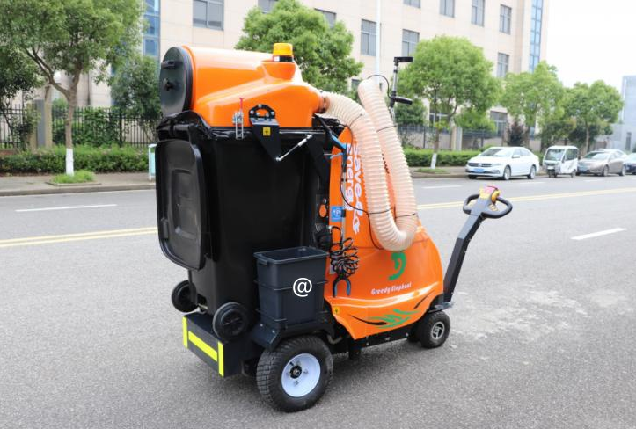
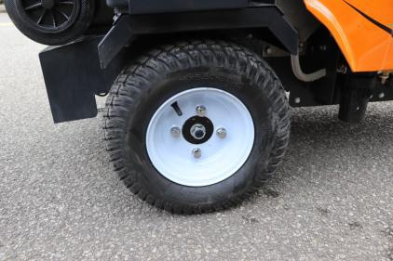
4. Driving method
Electric rear axle drive
AC motor drive
The whole machine adopts electric rear axle drive, driven by a 2.2kw AC motor, equipped with customized AC controller control. It is designed with the functions of steep hill descent, uphill start, under-voltage alarm and so on.
The drive mode is designed with high and low gears, with a maximum speed of 1km/h in low gear and 6km/h in high gear.
The speed can be infinitely adjusted with the knob in each speed gear.
7

Slide 10
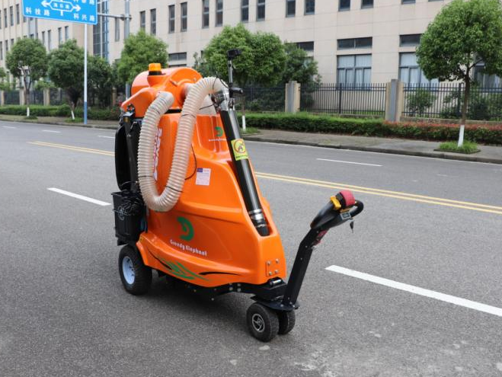
5. Steering mode
Under the traction hand-control drive mode, it adopts manual front wheel steering and parallel double steering wheel design, which makes the whole machine more stable and safe.
The structure is as shown in the figure above, and the left and right steering angles are 85°.
8

Slide 11
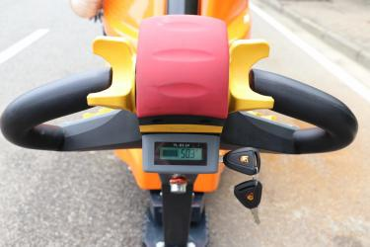
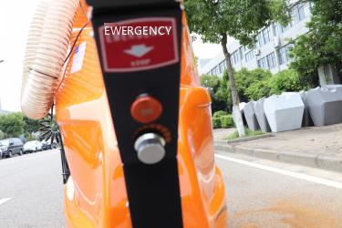
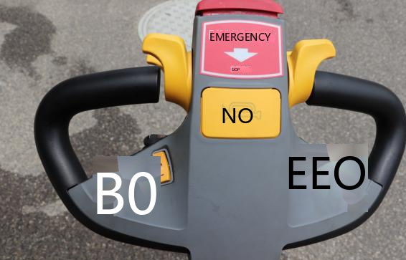
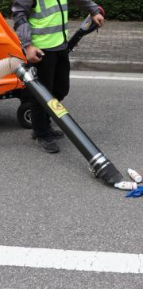
6. Description of operations and keys
actuating switches
Voltage display
Emergency stop switch
Switch key
Emergency stop switch
Drive speed control knob
Work light switch
High-pressure pump switch
Fine mist dust switch
Horns
light switches
Vacuum fan high and low speed gear switch
drive mode switching
Vacuum fan switch
9

Slide 12
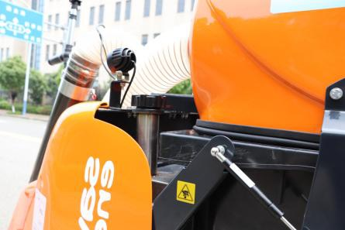
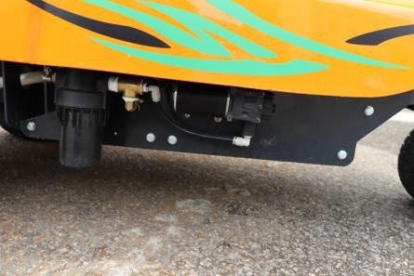
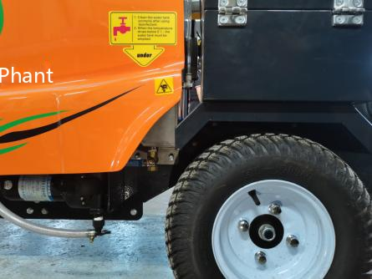
Water filler
Water tank volume 60L.
Water needs to be added.
water filters
Stainless steel filter mesh construction.
It needs to be disassembled and cleaned from time to time.
Drainage outlets
Water needs to be drained from the tank when the temperature is below 0°.
10

Slide 13

7. battery-related instructions
The charger that comes with the car
Dust Extraction Fans
Controller
Battery X4
Vehicle charger (with power cord)
Input voltage:220V
Output voltage:48V
Charging current:12A
Power:750W
Battery: Maintenance-free lead-acid battery
Model:12V84Ah battery 4 pcs
System voltage:48V
Controllers: including drive motor control (AC), fan motor controller (AC), DCDC, relays, etc.,
11

Slide 14
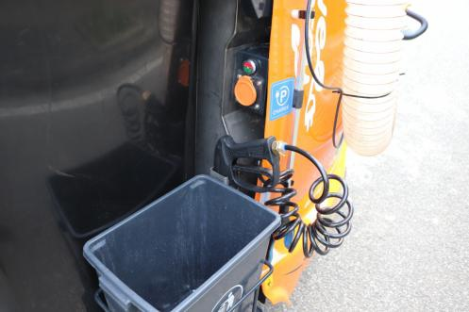
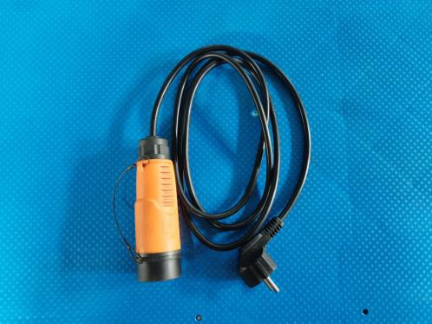
2
1. Charging port
2. Charging indicator
1
Charging power cord
Input voltage 220V
Power 750W
12

Slide 15
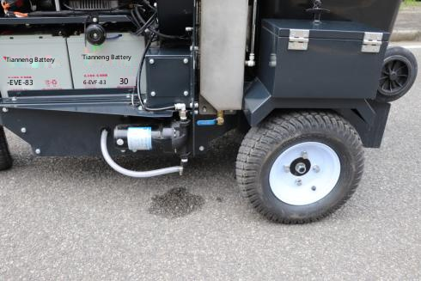
8. Description of high-pressure water gun
The high-pressure water jet system is driven by a 12V triple-plunger diaphragm pump with a maximum pressure of 5 bar and a maximum flow rate of 19 L/min.
High-pressure water guns can be used for cleaning and disinfecting work, and after disinfecting work you need to clean the water tank and pipes.
When the water tank is empty, the pump needs to be turned off.
Cleaning pumps, tank level indicators, drain ball valves
13

Slide 16
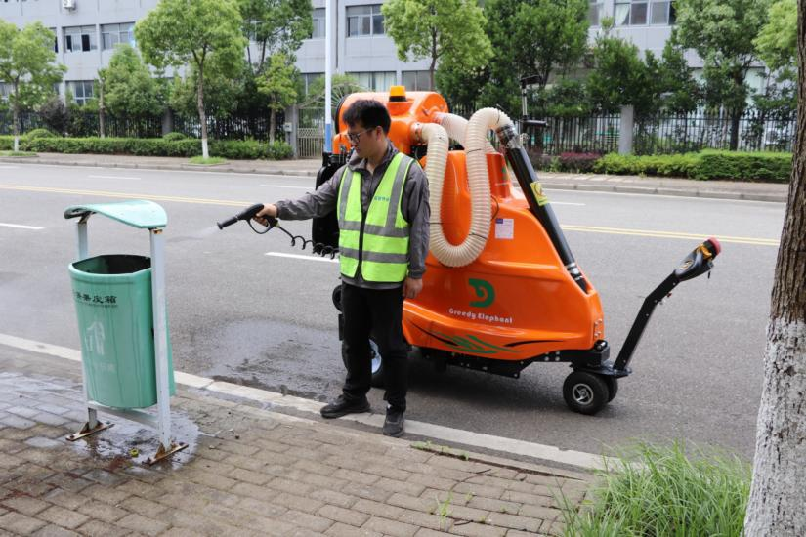
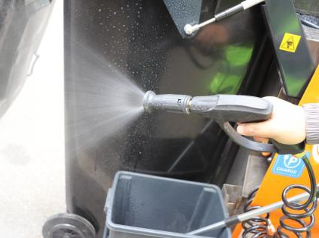
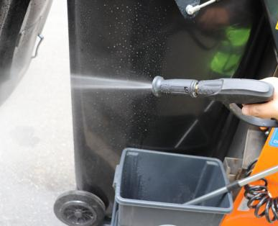
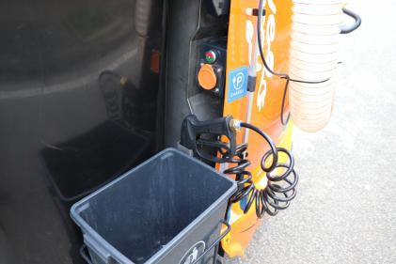
Adjustable angle of water discharge from water gun
The pump has an automatic start/stop function
14

